Slide 1
Information:
The first part is the original presentation made by Mino; based on data (cloud fraction) of 2 years.
The second part is the added analysis made by myself (not finished yet),to complete the work, including
the extended of data, about 3 years.
A climate analysis of Cloud fraction of the 3 years, to identify the data structure and understand model behaver.
More detailed model bias analysis:
Bias distribution
Bias vs cloud levels: can APCADA really detect high level cloud ?
Bias vs hour in the day: the model performance along the day ?
Bias vs unit (octas or 0-1): the faire comparison between APCADA et XGBoost.

Slide 2




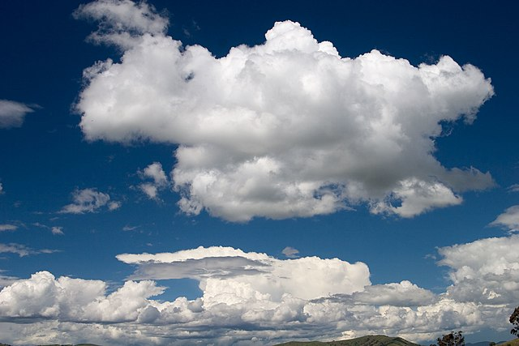
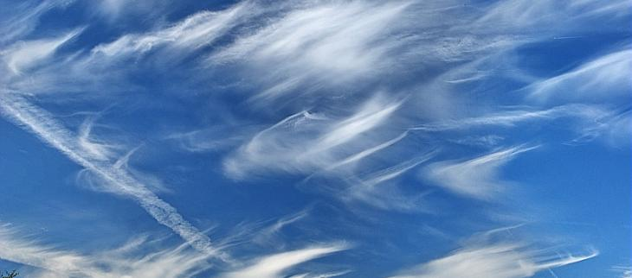






ITISE 2022 - 27th-30th June
Gran Canaria (Spain)
Estimation of Cloud Fraction over the South West Indian Ocean using BSRN Surface Observations
Tina Herimino Andriantsalama, Chao Tang, Remy Ineza Mugenga, Thierry Portafaix, Mathieu Delsaut, Alexandre Graillet, Patrick Jeanty, Girish Kumar Beeharry, Roddy Lollchund, Tyagaraja S. Modelly Cunden, Béatrice Morel

Slide 3

Outline
Introduction
Data and methodology
Results
Conclusion and perspective
Chao: Add a motivation please

Slide 4

Introduction
Estimation of Cloud Fraction (CF) with daytime observation from the BSRN (Baseline Solar Radiation Network) station of La Réunion in the South West Indian Ocean, using a XGBoost machine-learning (ML) model and Automatic Partial Cloud Amount Detection Algorithm (APCADA)
Important influence of clouds on the Earth’s radiation budget
CF: fraction of the atmosphere volume or projected area occupied by clouds [unit: octat]
Automatic Partial Cloud Amount Detection Algorithm (Dürr and Philipona, 2004), input: LWD, T and RH ; output: CF [octat], for estimation
XGBoost machine learning model (https://xgboost.readthedocs.io/en/stable/), input: longwave, shortwave irradiance, T and RH ; output: CF [octat], for estimation
Chao: highlight APCADA = physical model

Slide 5
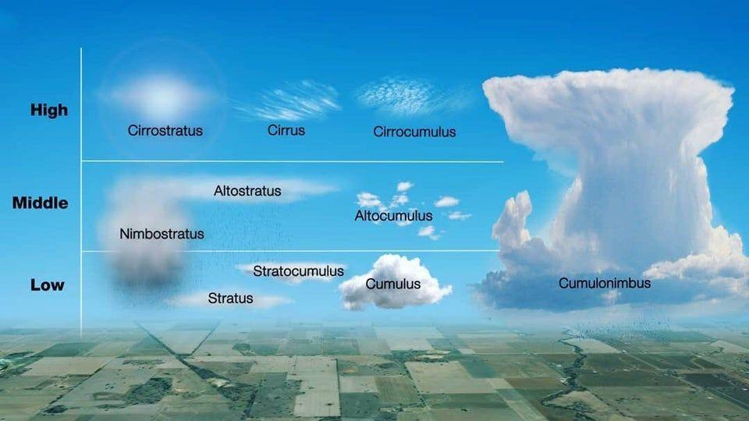
Introduction
Class of clouds:
Fig. 1: Different type of clouds
(Source: https://media.bom.gov.au/social/blog/895/whats-that-cloud/)
Estimation without high class CF for APCADA
Estimation with all class of clouds for XGBoost
Physical meaning ?
Depends on OBS/REF data

Slide 6
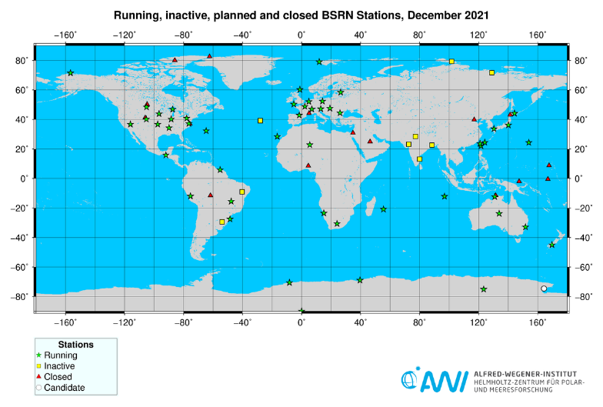
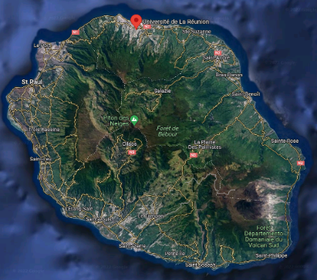
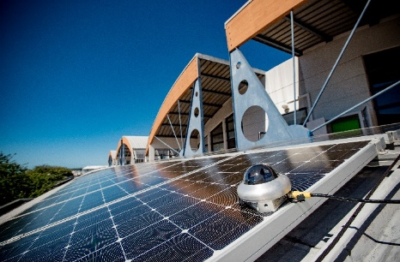
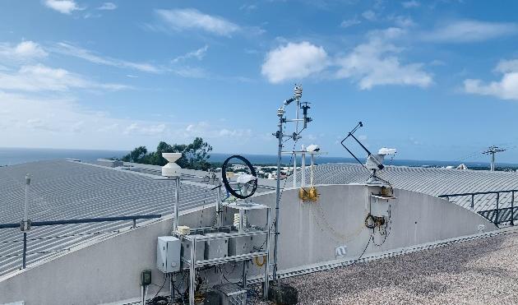
I. Data and methodology
Reunion station BSRN location:
Fig. 2: Map stations BSRN
(https://bsrn.awi.de/nc/stations/maps/), Reunion station and Energie lab

Slide 7
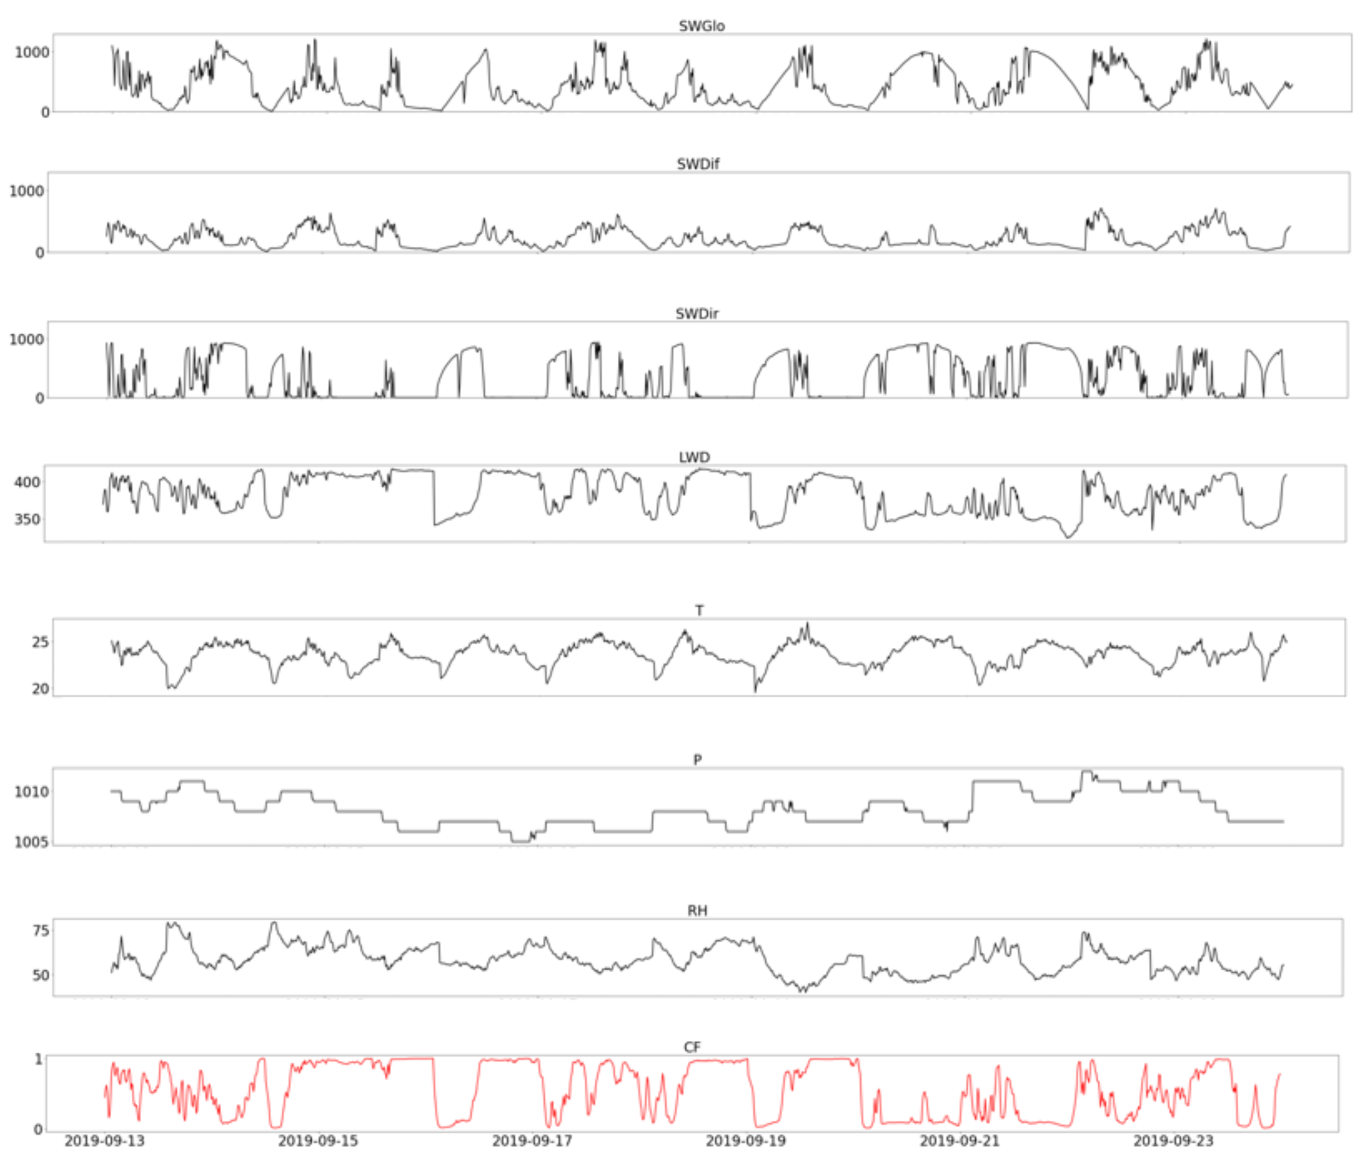
I. Data and methodology
Parameters and instruments:
Table 1 : Parameters and sensors
Variables, name (unit) | Sensor Manufacturer | Comment
Incident shortwave global horizontal irradiance, SWGlo (W/m2) | CMP22 | BSRN
Incident shortwave diffuse horizontal irradiance, SWDif (W/m2) | Kipp and Zonen | BSRN
Incident shortwave direct horizontal irradiance, SWDir (W/m2) | CHP11 Kipp and Zonen | BSRN
Incident longwave downward, irradiance, LWD (W/m2) | CGR4 Kipp and Zonen | BSRN
Surface air temperature, T (°C) Surface air pressure, P (hPa) Relative humidity, RH (%) | WXT530 series Vaisala | multi-parameter weather transmetter
A cross correlation could help here.
Fig. 3 : Data sample from Reunion station BSRN and CF
The data from the BSRN Moufia station have passed an automatic and manual quality control according to the BSRN quality control rules.

Slide 8
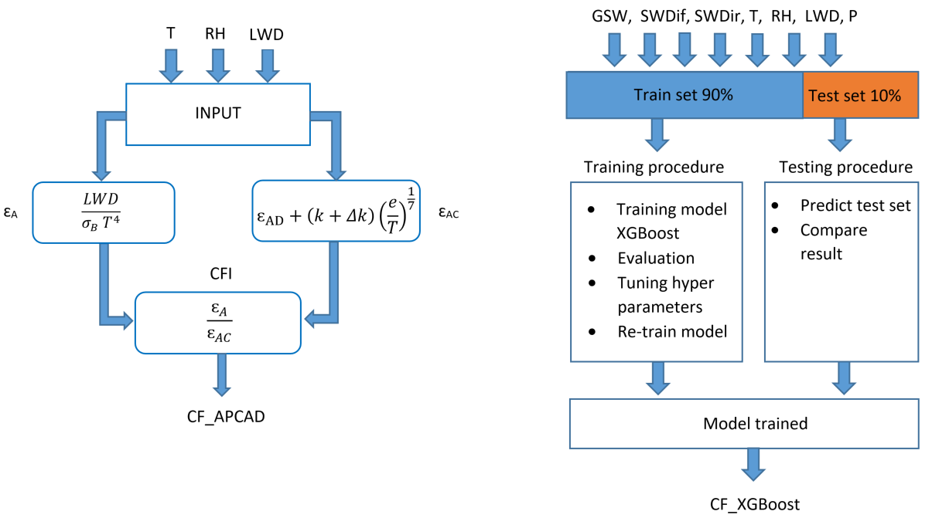
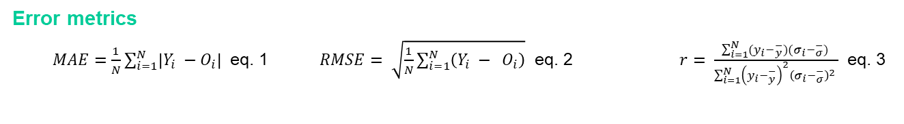
I. Data and methodology
APCADA Model
XGBoost Model
Fig. 4: APCADA (left) and XGBoost (right) workflows
Error metrics
$MAE=\frac{1}{N}\sum_{i=1}^{N}{\left|Y_{i} −O_{i}\right|}$ eq. 1 $RMSE= \sqrt{\frac{1}{N}\sum_{i=1}^{N}{\left(Y_{i} − O_{i}\right)}}$ eq. 2 $r= \frac{\sum_{i=1}^{N}{(y_{i}−_{y}^{−})(σ_{i}−_{σ}^{−}}) }{\sum_{i=1}^{N}{{\left(y_{i}−_{y}^{−}\right)}^{2}{\left(σ_{i}−_{σ}^{−}\right)}^{2}} }$ eq. 3

Slide 9
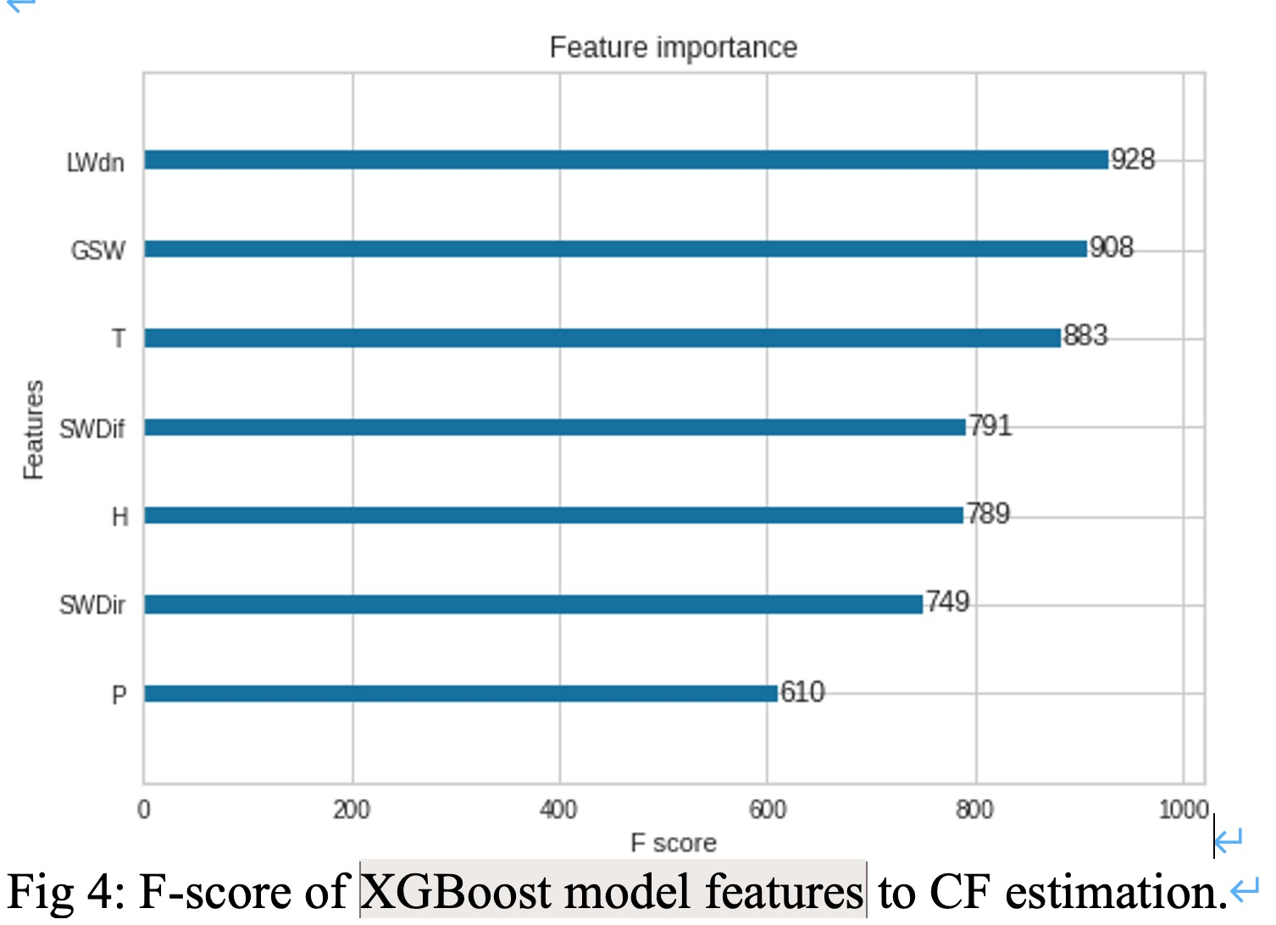
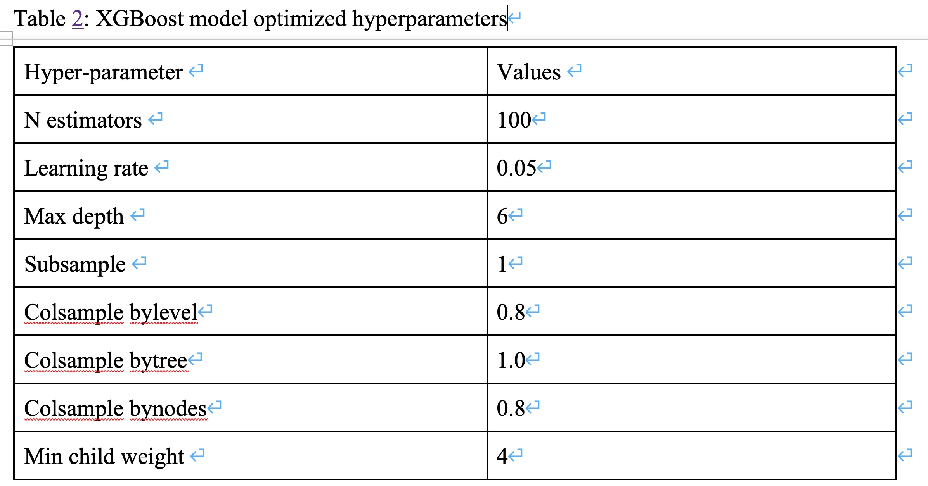
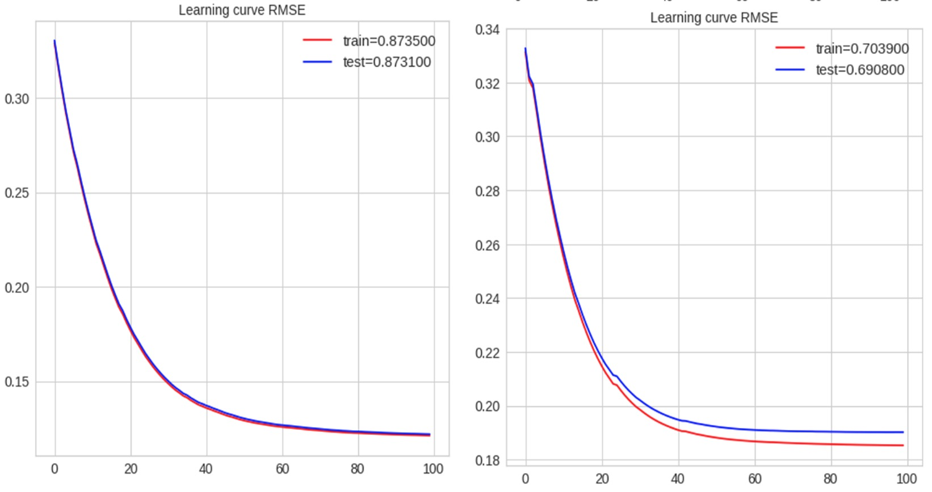
I. Data and methodology
XGBoost Model
A table of data use (training/testing) is needed
Optimization method

Slide 10
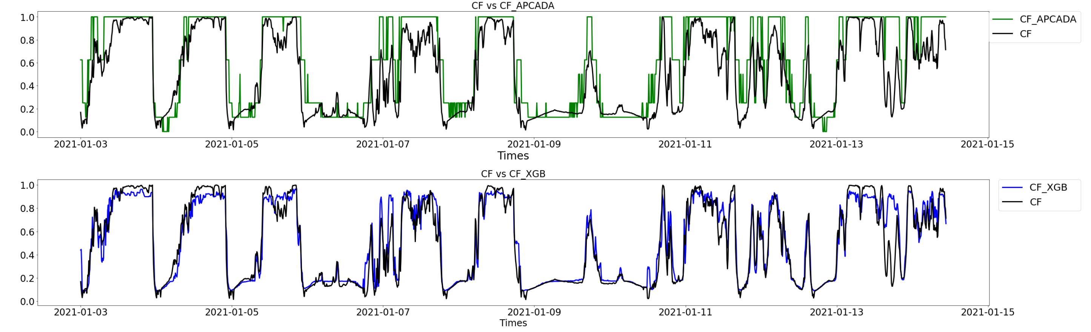
II. Results
Results from the APCADA model and the XGBoost model with comparison to the CF observation:
Figure 5: Comparison of the estimation results of the apcada and xgboost models
Table 2: Error metrics and Correlation between CF estimations and observation
Estimations | RMSE | MAE | r
CF vs CF_XGB | 0.12 | 0.08 | 0,93
CF vs CF_APACADA | 0.23 | 0.16 | 0,84
CF_XGB vs CF_APCADA | 0.21 | 0.16 | 0,89

Slide 11
III. Conclusion and perspectives
Only daytime CF, from the visible camera, is used to train the XGBoost model and to evaluate APCADA model in this study. Compared with APCADA, XGBoost performs better with correlation of 8% higher than APCADA. With this performance, the XGBoost model could be applied to extend the temporal coverage of existing CF observations from about 1.5 year in this study to more than 2.5 years with available meteorological variables. In addition, a similar experiments could be done during the night with nighttime CF measurement such as that from an infrared camera.

Slide 12
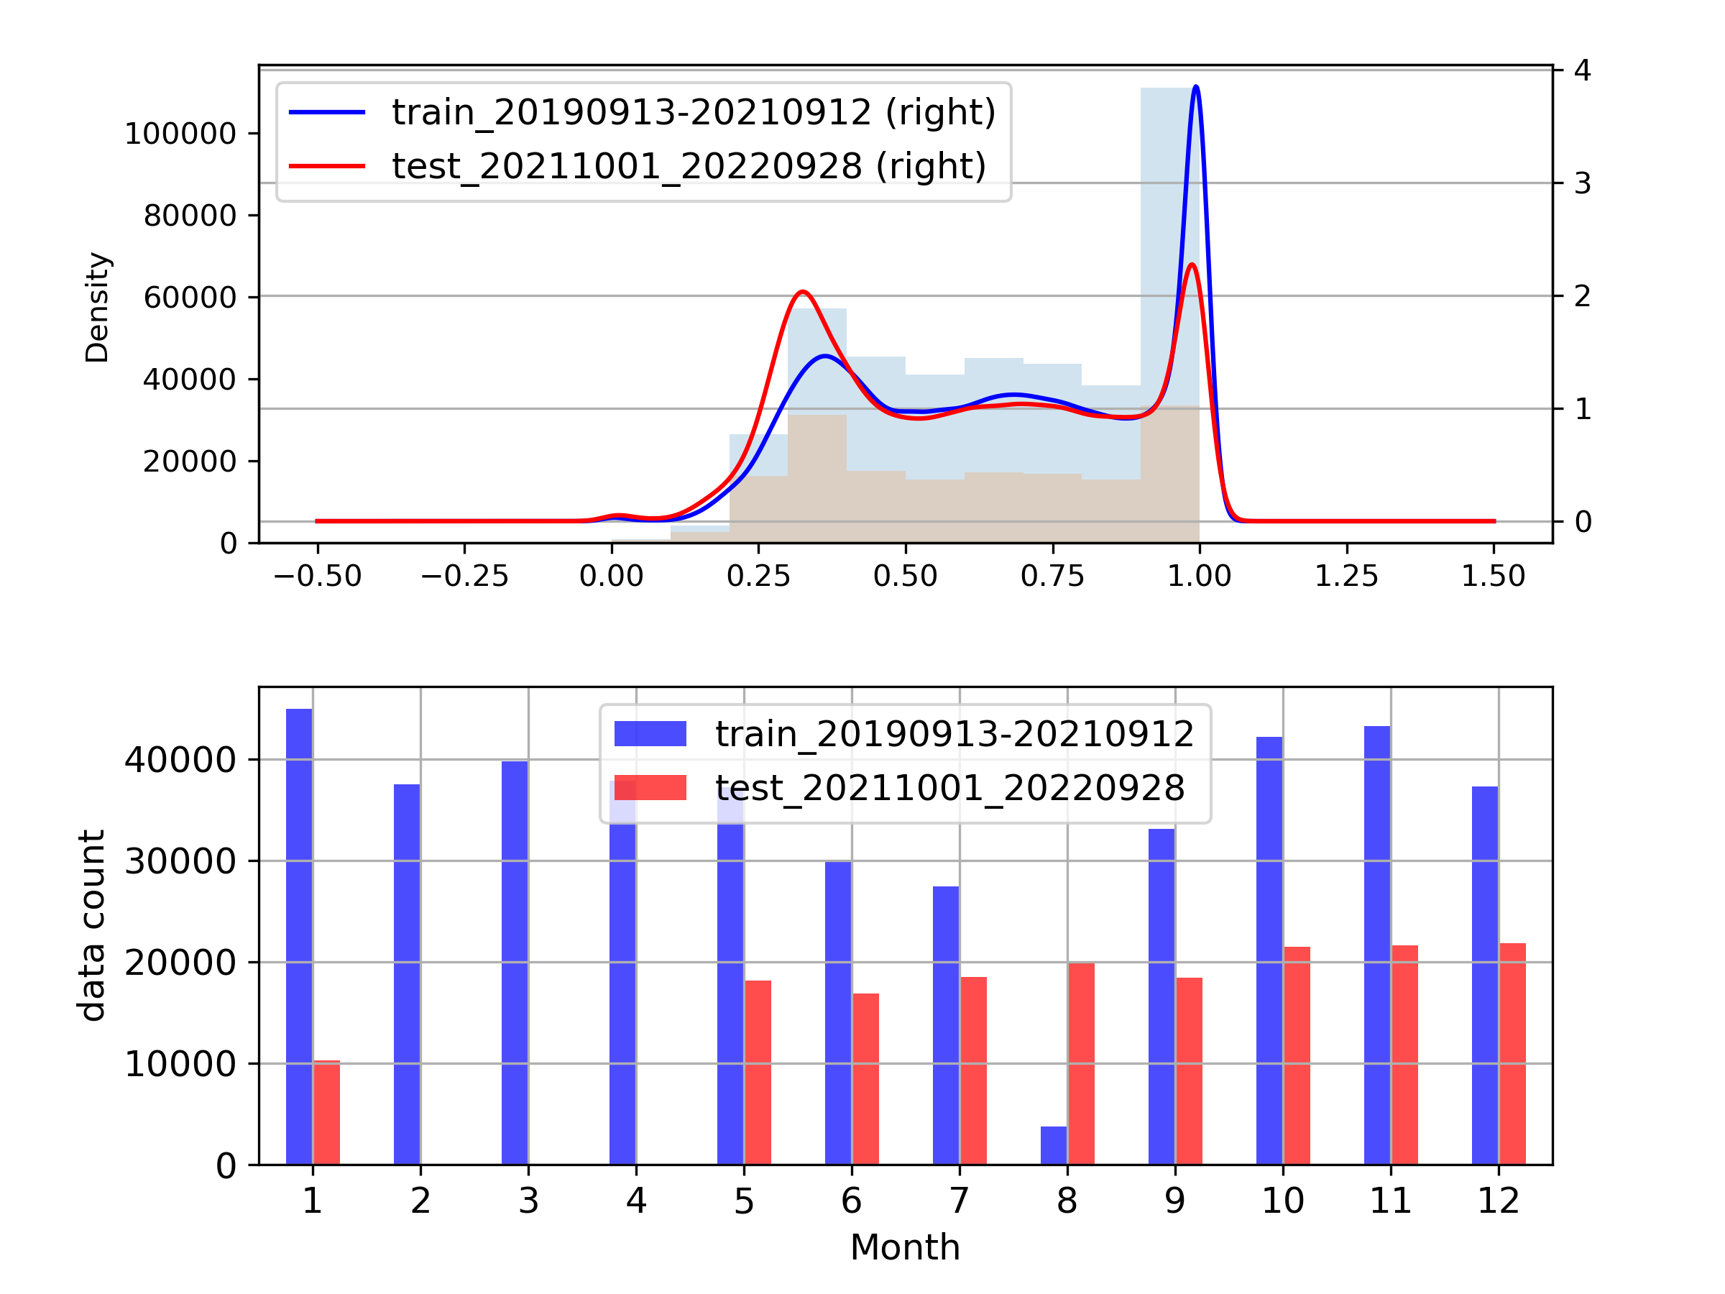
To improve:
Parameters and instruments:
Observation cloud fraction:
5 min data between March 13, 2019 and February 1, 2021.
Extended dataset to 3 years ?
Benefits:
To account for the difference between years, for better generation performance.
More feeding to the GXB model. ( to see if necessary).
difficulty:
The testing period with data gap (table in the next slide) has a different distribution of CF.

Slide 13
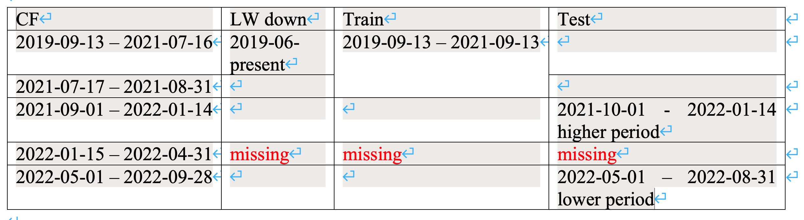
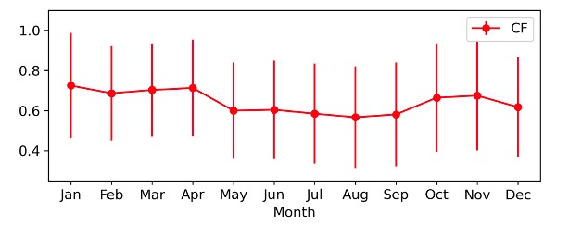
To improve:
Parameters and instruments:
Observation cloud fraction:
5 min data between March 13, 2019 and February 1, 2021.
Extended dataset to 3 years ? So that 2 year could be used for training, and 1 year for testing, even with a gap of months:
difficulty:
There is a big data gap, months of data (above table), then it is necessary to test the representative of model performance during the testing period (the core of two seasons) for Could Fraction (CF), a variable with strong seasonality figure right.
The performance (or even the loss function) may need different turning at different season ? Maybe not.

Slide 14
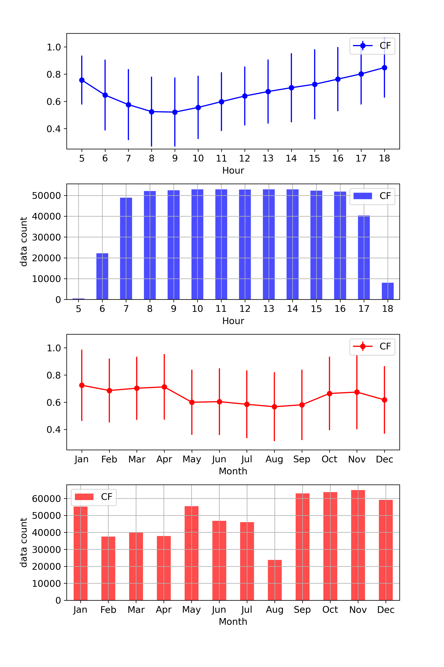
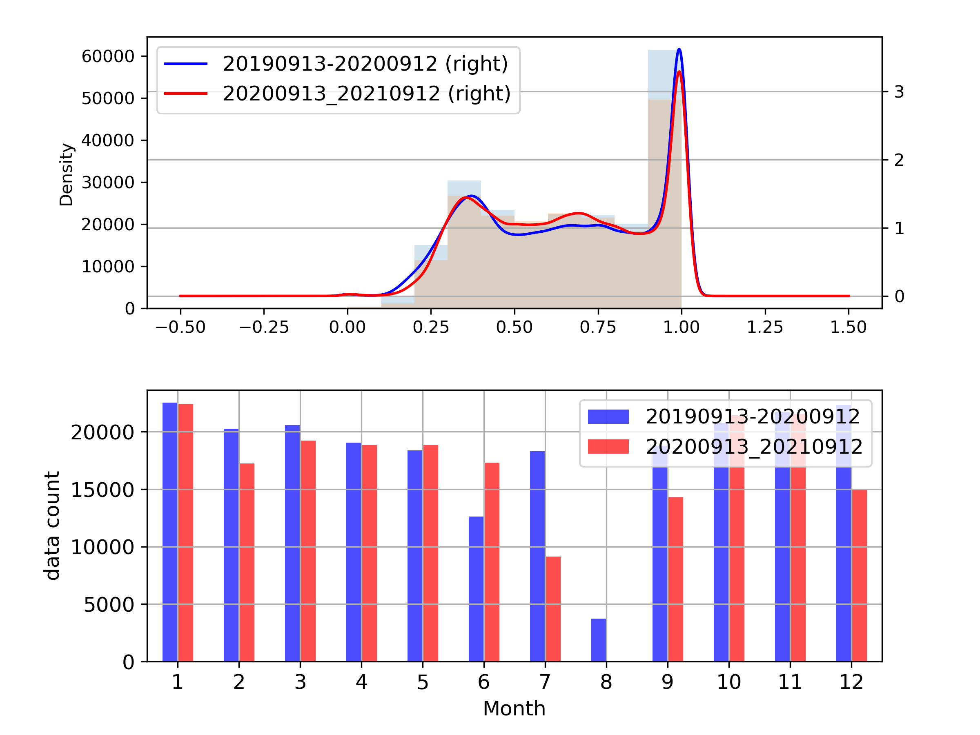
I. Data and methodology
Parameters and instruments:
2. More analysis on OBS:
Result of 2-year data

Slide 15
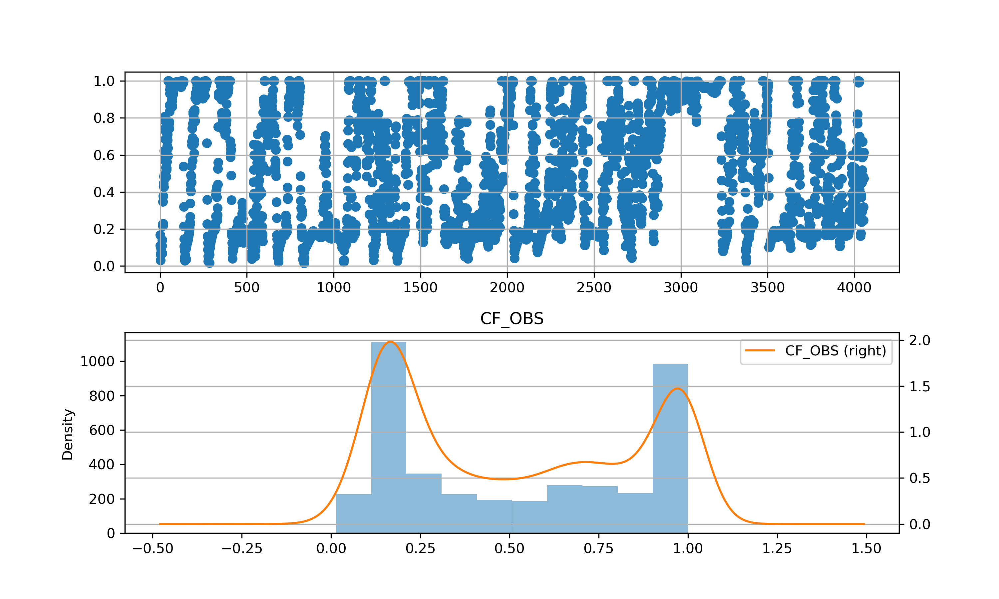
I. Data and methodology
Parameters and instruments:
2. More analysis on OBS:

Slide 16
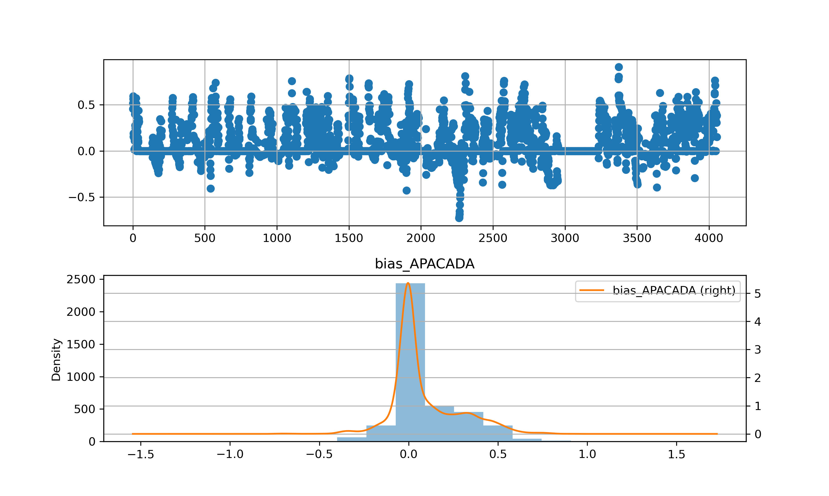
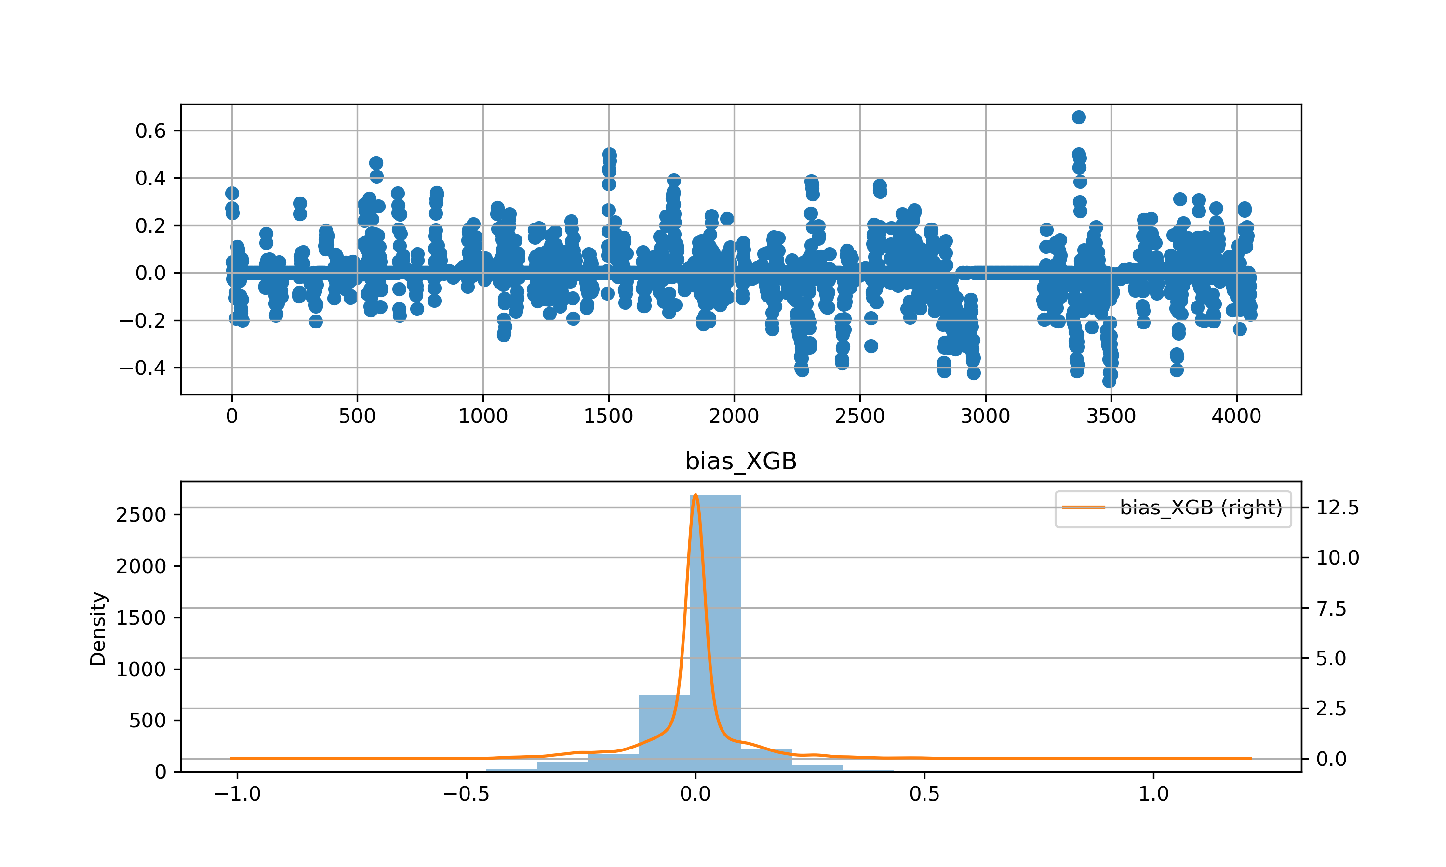
2. More analysis on results:
Result of 2-year data
Bias distribution
Bias vs cloud levels
Bias vs hour in the day
Bias vs unit (octas or 0-1)
The analyses of model performance (bias) should be improved and completed:
Gaussian bias produced by two methods: Good.

Slide 17
2. More analysis on results:
Bias distribution
Bias vs cloud levels
Bias vs hour in the day
Bias vs unit (octas or 0-1)
APCADA give values in octas, integer from, 0 to 8, with higher values indicates higher cloud fraction.
The calculation of error matrix, such as R and MAE, mean error (even not exited yet, to be completed), may be skewed by the discontinuity of APCADA results.
Given XGB give continuous values between 0 and 1, comparison between these two is somehow not faire, especially strong fluctuations of cloud happening at very short timescales (the data resolution is 5-minutes of the two methods).
So, I make conversion between these two units (next slide), to make the comparison (not finished yet).

Slide 18
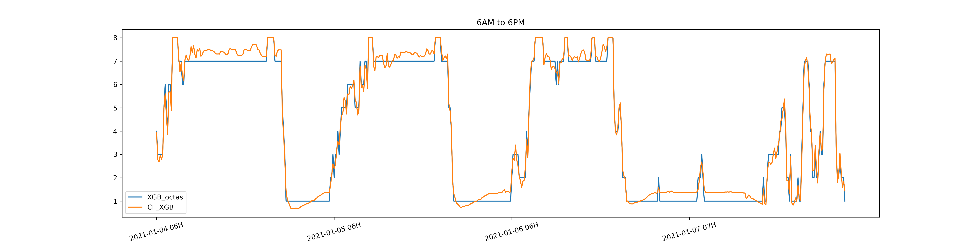
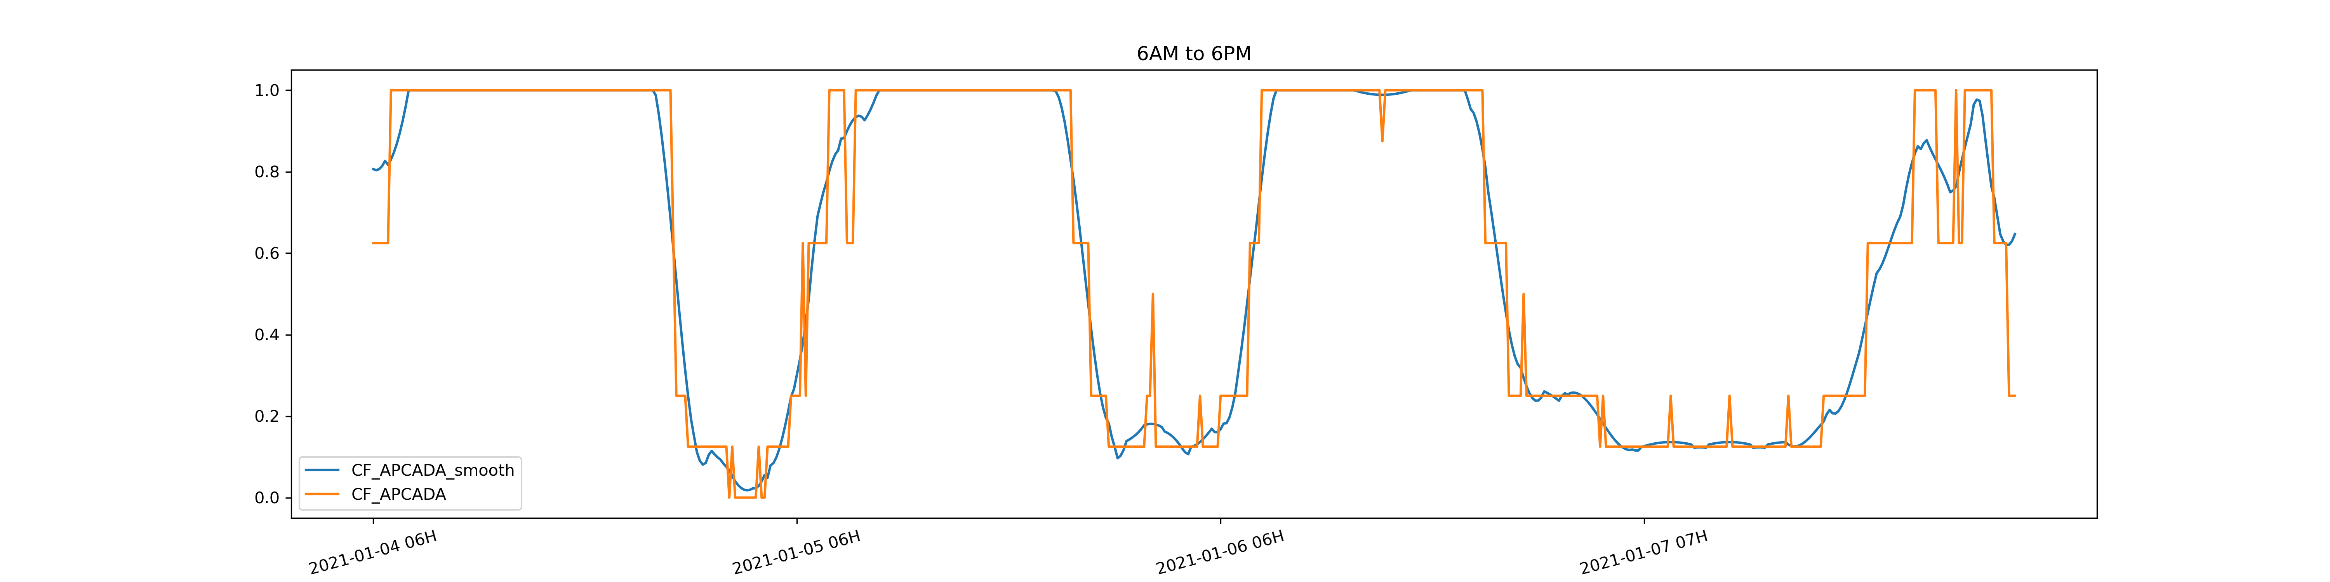
2. More analysis on results:
APCADA give values in octas, integer from, 0 to 8, with higher values indicates higher cloud fraction.
Bias distribution
Bias vs cloud levels
Bias vs hour in the day
Bias vs unit (octas or 0-1)
Convert GXB results to octas
Smooth of APCADA octas

Slide 19
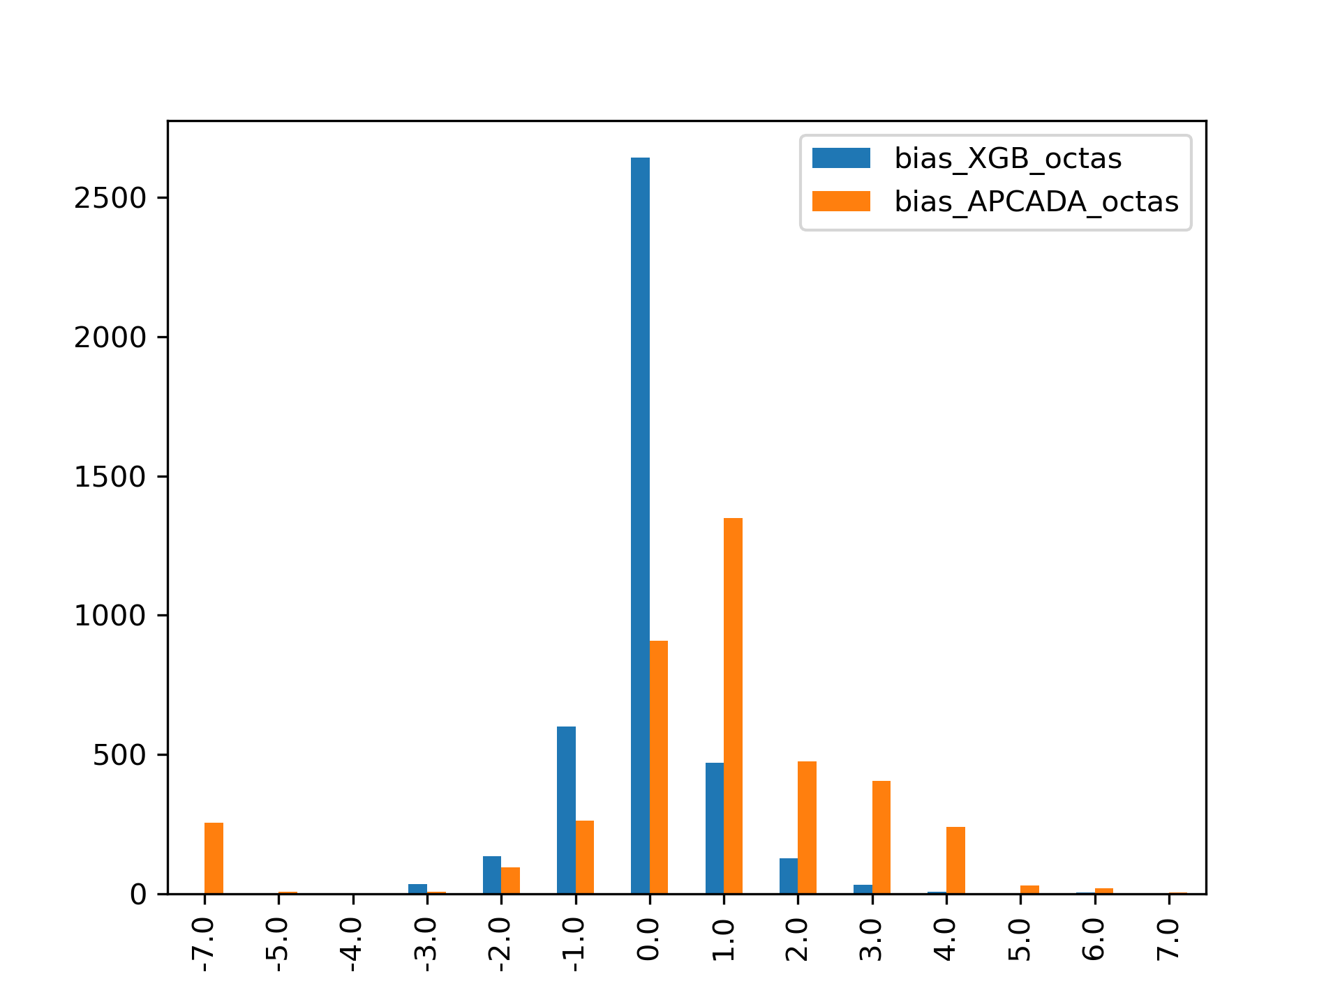
2. More analysis on results:
Bias distribution
Bias vs cloud levels
Bias vs hour in the day
Bias vs unit (octas or 0-1)
Convert GXB results to octas

Slide 20
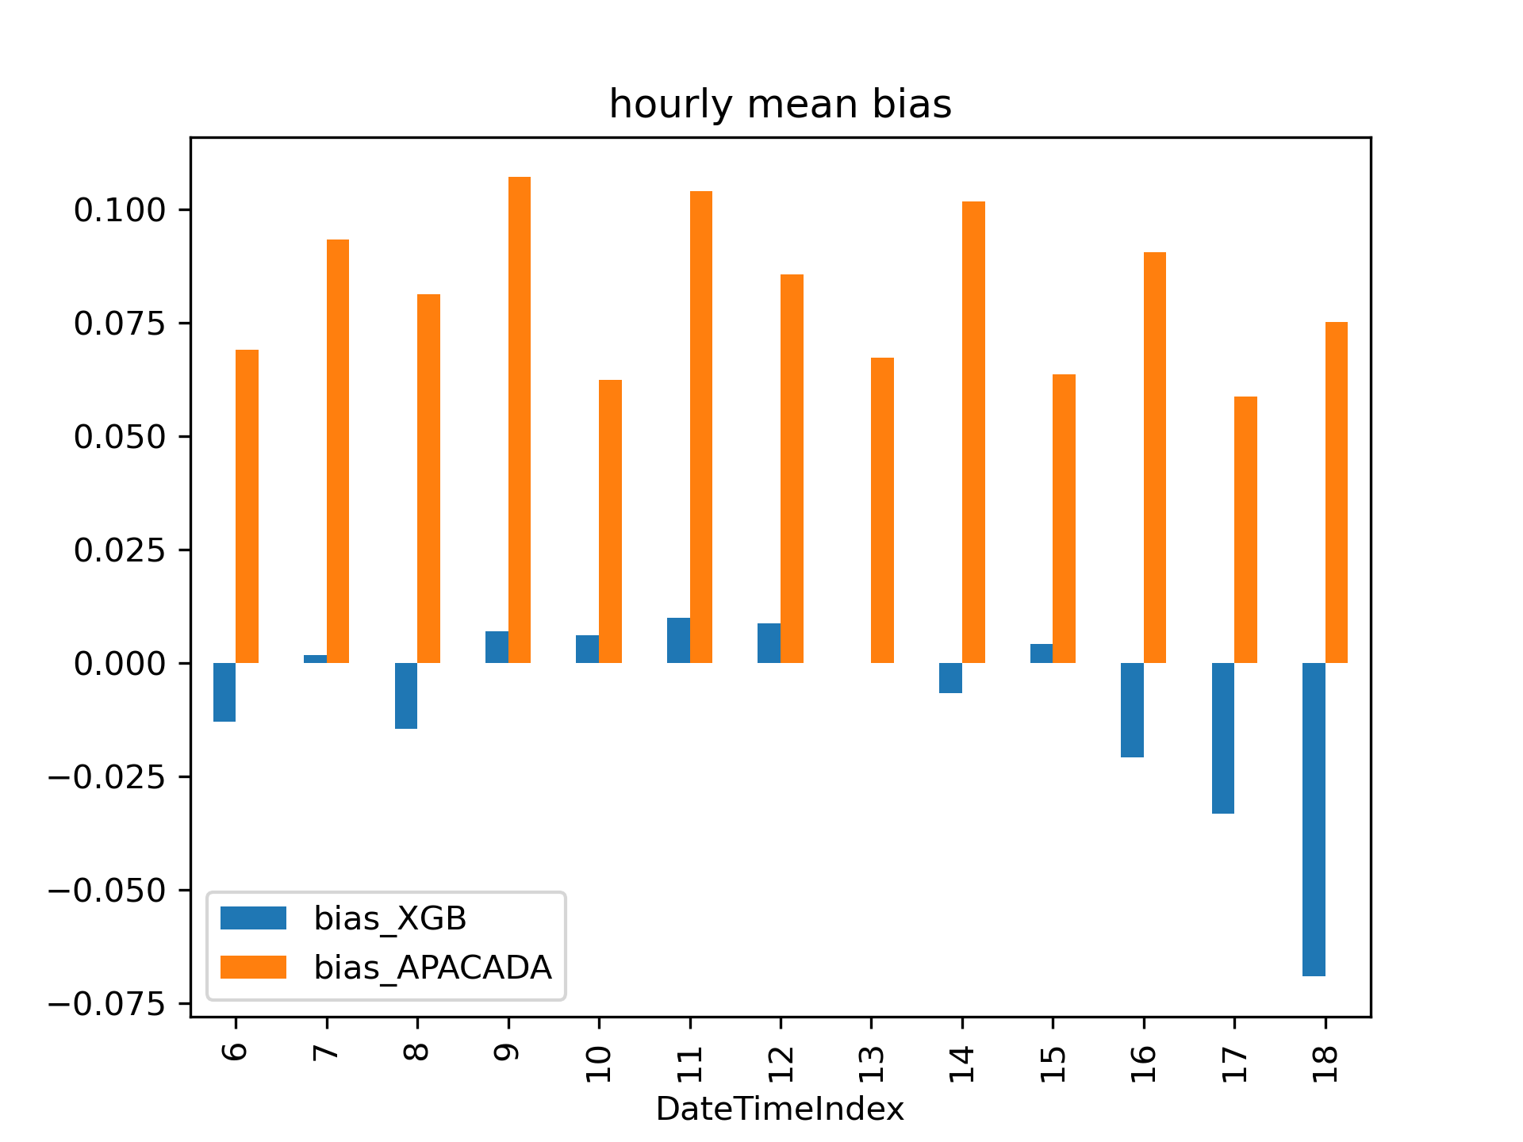
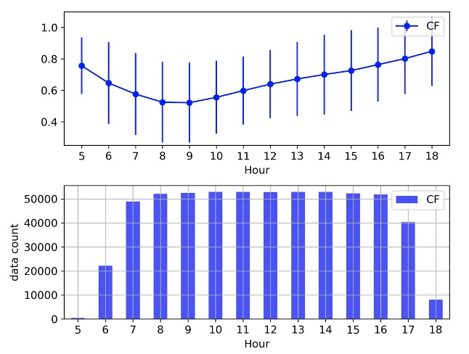
Physically, Cloud Fraction (CF) has a strong diurnality (figure left up plot). Secondly, the OBS from all-sky camera also has a limit on the sun altitude. So that, the data is largely missed during this period.
It’s important/necessary to identify the model performance at all the predicted hours.
GXBoost is sensitive to the data amount, so it’s performance is relatively low, larger bias during these hours with low solar altitude.
On other side, APCADA has a flat bias during the all the hours.
2. More analysis on results:
Bias distribution
Bias vs cloud levels
Bias vs hour in the day
Bias vs unit (octas or 0-1)

Slide 21
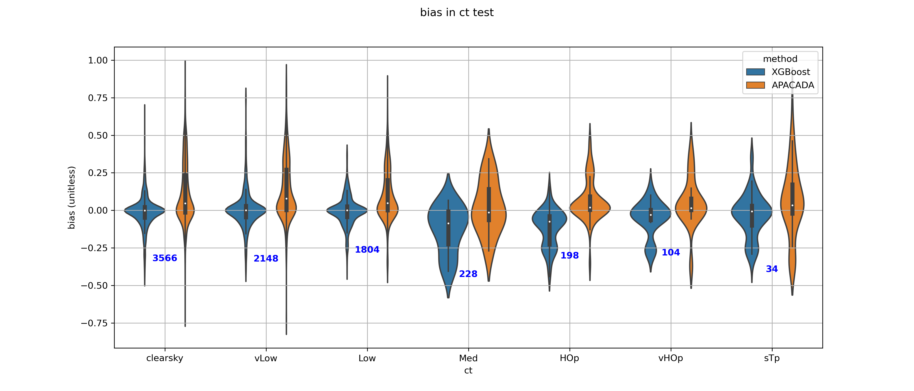
2. More analysis on results:
Since LWD measured at the Earth’s surface is marginally affected by high clouds because of large distance and cold emittance temperature, as a drawback, APCADA can detect only total cloud amounts without high clouds
Bias distribution
Bias vs cloud levels
Bias vs hour in the day
Bias vs unit (octas or 0-1)
Clearsky and low cloud : overestimated by APCADA
Improved by GXB

Slide 22
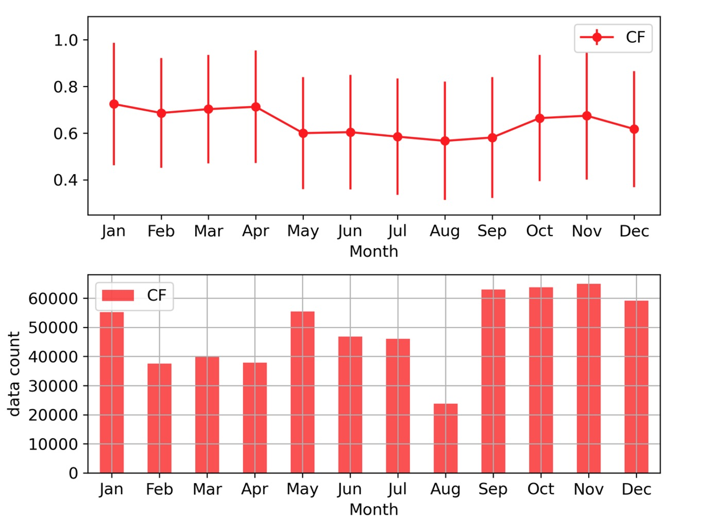
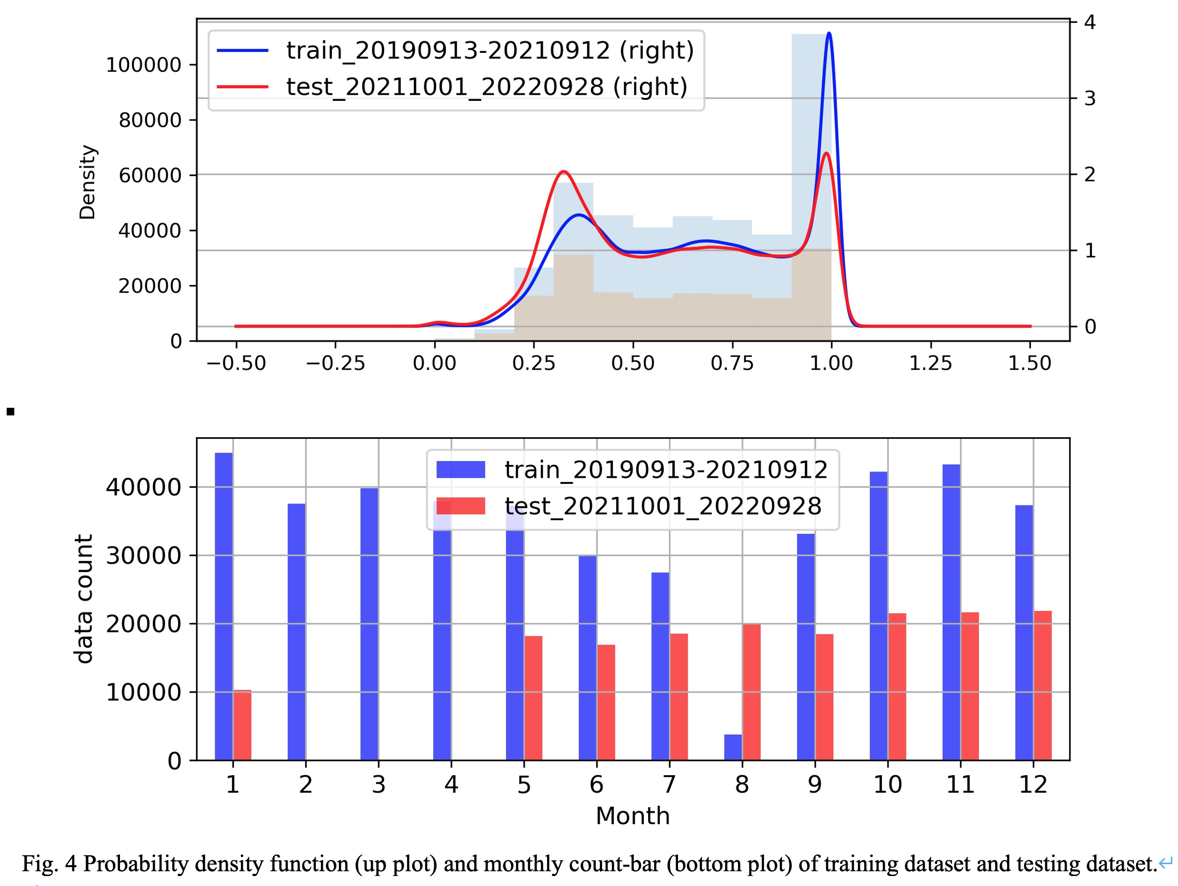
To see if it’s possible to testing XGBoost using the data of less than a year, given the variable nature of meteorological parameters, i.e., cloud fraction.
If so, the two periods could be used, including the core months of winter and summers, shown in the right plot, on bottom.
Extended dataset to 3 years

Slide 23
I. Data and methodology
To do
Motivation
Improvement of APCADA:
High cloud detection
Continuous output
Lack of LW → cloud climate analysis.
Method: benchmark, model selection, etc..
Optimisation of XGBoost model: 1) feature engineering, optimization of parameters.
Update literature review
Detailed validation and Interpret results
Improve writing

Slide 24
Some raw ideas from Chao:
A description and analysis of Lacy CF data is not yet complete (missing actually). A brief description could help to improve the presentation (which variable is used, freq., relative role of thin and thick cloud, etc).
For the scientific motivation of this research: a) as you said in the ppt, APACADA performs worse for high cloud, while XGBoost is for all types (depending on the predictant, i.e., lacy data, that’s a season why we need a description of lacy data). That’s could be potentially a powerful advantage of XGBoost. We could first confirm the APACADA’s low-level skill during the high cloud period, relative to its performance in the period of low cloud. We could select the periods using lacy data (or other data, such as era5). And then to see how XGBoost behaviors in low/high cloud periods. (Attention: for lacy CF: Toute les fractions nuageuses plus-haut sont calculées pour un angle zénithal inférieur à 75 degrés). The idea is to show and prove that XGBoost could improve cloud estimation and especially the high-cloud estimation.
CF_APACADA produces discrete values, we may have to be careful in the model evaluation: just try to figure out the influence of the discreteness. a) first we’d better to confirm if it’s a normal distribution, so that we could use perssion correlation safely. b) for MAE or PMAE, we could try to smooth the CF_APACADA series to see if the results will be largely changed.
I think it’s better to apply XGBoost for all available data in the paper.

Slide 25
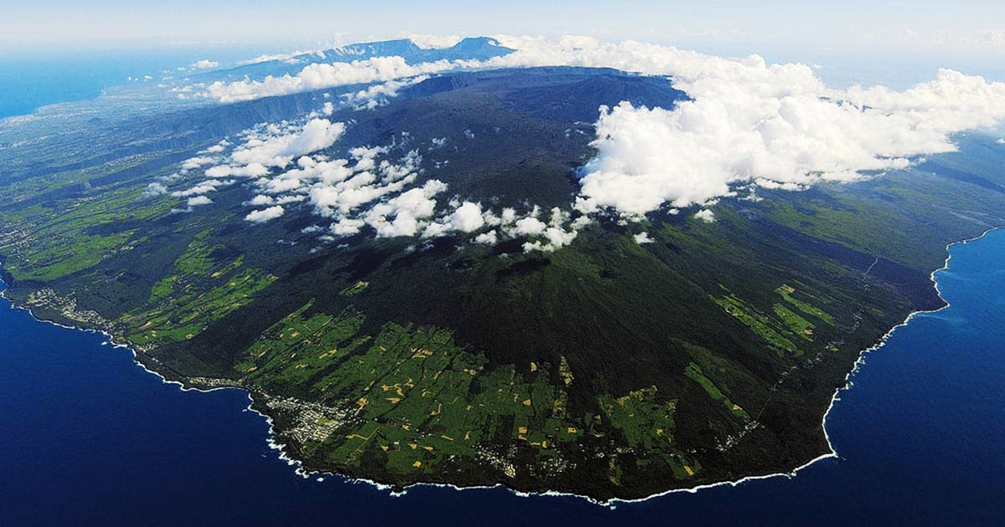
Thank you !

